Slide 1



ADREETA GUHA M.S., ANALYTICS UNIVERSITY OF SOUTHERN CALIFORNIA

Slide 2
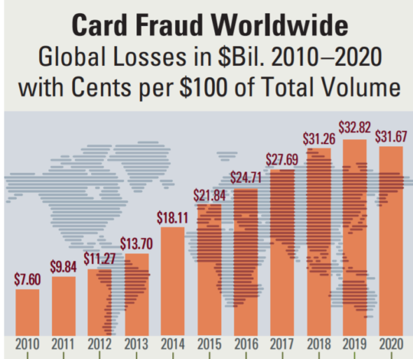
Credit Card Transaction Fraud
Credit card fraud is a type of theft that occurs when someone that is not you uses your credit card or account information for an unauthorized purchase. Fraud can happen as a result of a stolen, misplaced, or counterfeit credit card.
United States is the most credit card fraud prone country in the world.
According to Federal Trade Commission’s (FTC), instances of credit card fraud in the US increased by 44.6% from 271,927 in 2019 to 393,207 in 2020 which resulted in a loss of approximately 3.3 billion dollars.
Credit card fraud accounted for 393,207 of the nearly 1.4 million (~28.08%) reports of identity thefts in 2020.

Slide 3
Project Framework
EDA
DC
FE
FS
MA
C&R
Exploratory Data Analysis
Data Cleaning
Feature Engineering
Feature Selection
Model Algorithms
Conclusion and Results

Slide 4
Exploratory Data Analysis

Slide 5
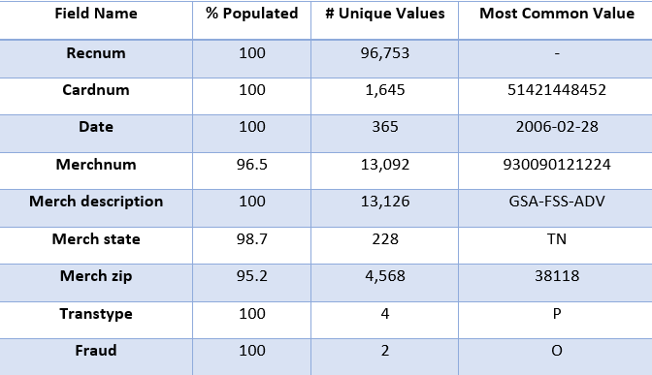
Exploratory Data Analysis: Data Description
Dataset Name- Card Transaction Data
Dataset Description – Dataset contains information on the actual credit card purchases from a US government organization. It provides information on Credit Card, Merchant, Date, and Amount involved in each transaction. Moreover, it also contains a column called fraud label which tells us whether the transaction is fraudulent or not.
Total Fields – 10
Total Records – 96,753
Time Period - 1st January 2006 – 31st December 2006
Summary Table for Numerical Variables
Summary Table for Categorical Variables

Slide 6
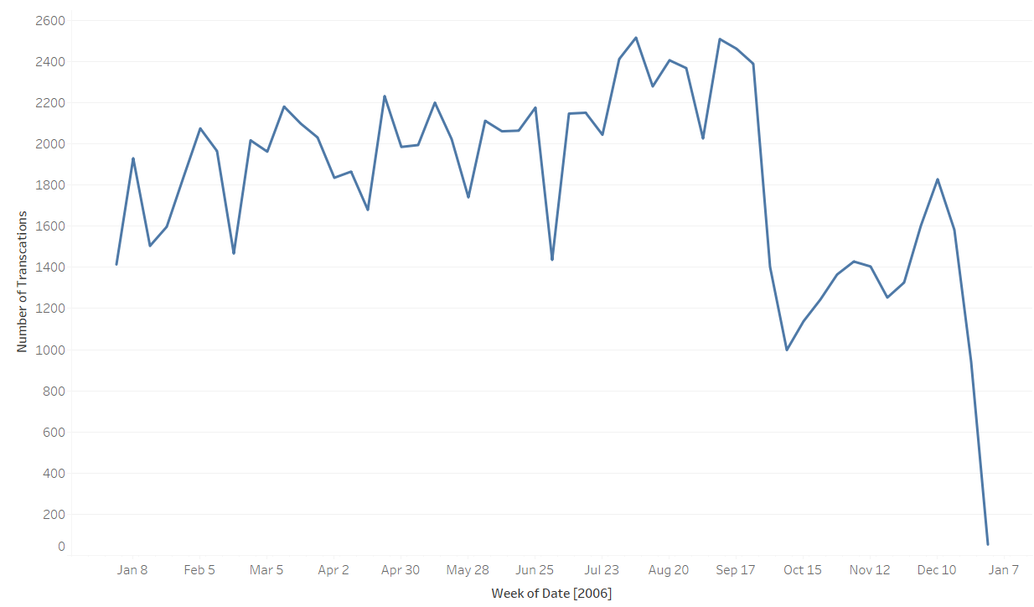
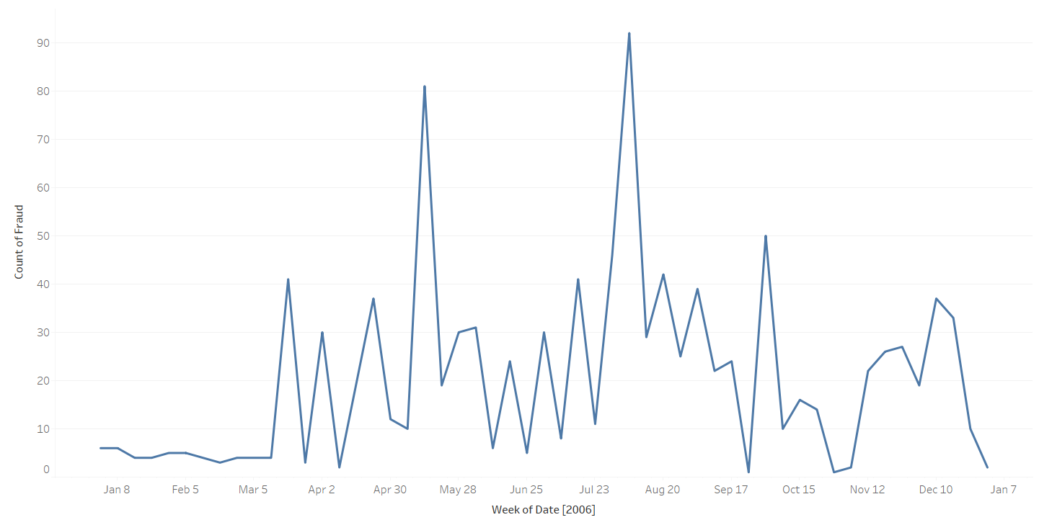
Exploratory Data Analysis: Important Fields
Number of Transaction per Week
Number of Fraud per Week

Slide 7
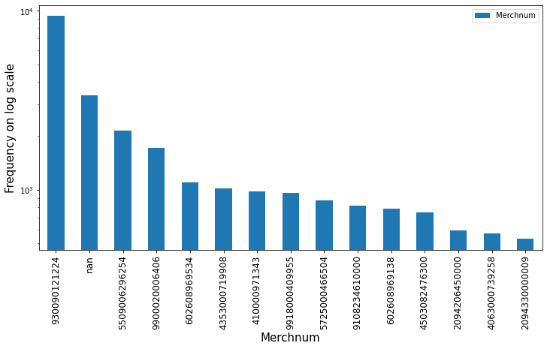
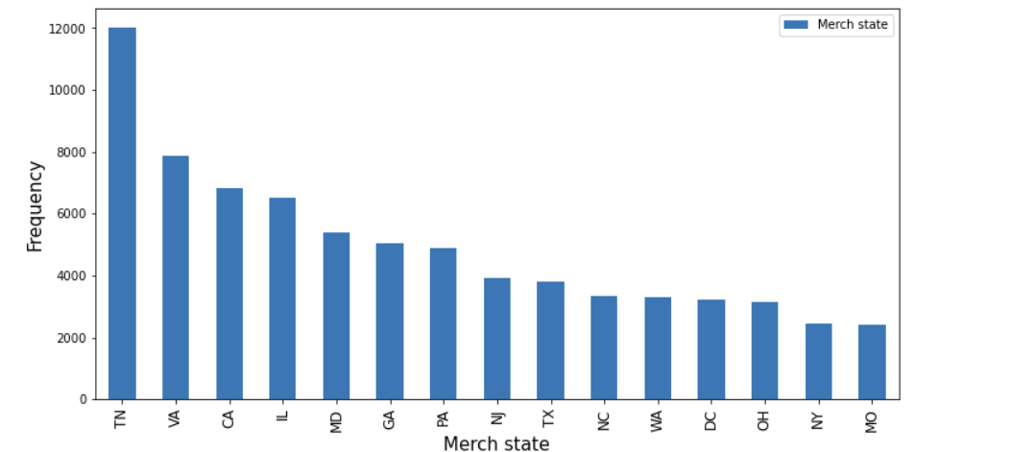
Exploratory Data Analysis: Important Fields
The field Merchnum provides information on the Merchnum of the merchant involved in the transaction.
The field Merchstate provides information on the state where the merchant involved in the transaction resides.

Slide 8
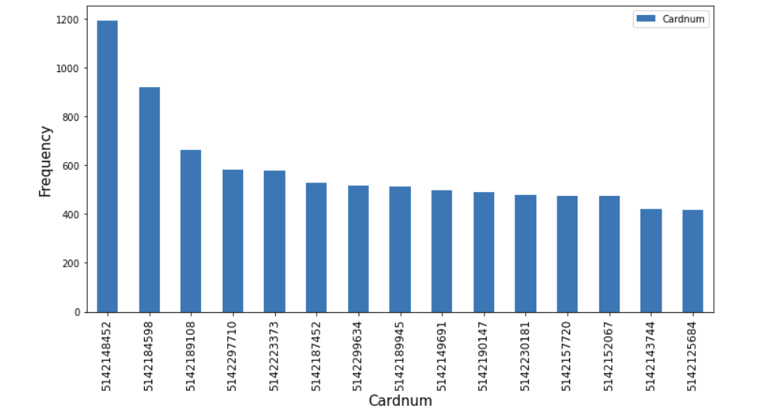
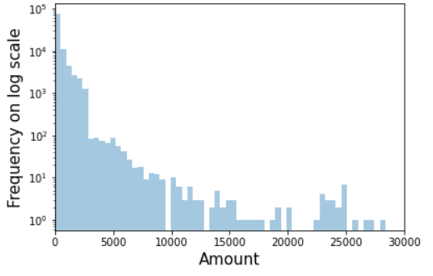
Exploratory Data Analysis: Important Fields
The field Cardnum provides information on the cardnum of the customer involved in the transaction.
The field Amount provides information on the amount of money involved in the transaction.

Slide 9
Data Cleaning

Slide 10
Data Cleaning
We only kept those records where ‘Transtype’ was P.
Removing Exclusions
We considered 100000$ as the threshold above which the purchase amount would be deemed as outliers. So, we kept the records where ‘Amount’ was less than 100000$ so as to narrow the decision region for the model.

Slide 11
Field Imputation
For the records that had zip number but missing state, we found the corresponding states to which the zip numbers belong and filled in the missing values by mapping to those states.
For the rest of the missing states, if the records had ‘Merchnum’ values,
we used mode of the states i.e. the state associated maximum number of times
with the corresponding Merchnum value. Otherwise, we had used ‘Merch description’
field’s values to fill in the missing states in a similar way.
Filling ‘Merch state’
(98.7%populated)
For records that were still blank, i.e. where ‘Merch description’ was ‘RETAIL CREDIT ADJUSTMENT’ and ‘RETAIL DEBIT ADJUSTMENT’, we used ‘unknown’ to fill in.

Slide 12
Field Imputation
We filled in the missing zip numbers for records that have ‘Merchnum’ and ‘Merch description’ by mapping with the mode of Merch zip i.e. the zip number that has been associated with the maximum number of corresponding Merchnum or Merch description.
Filling ‘Merch zip’
(95.2%populated)
For records that were still blank, i.e. where ‘Merch description’ was ‘RETAIL CREDIT ADJUSTMENT’ and ‘RETAIL DEBIT ADJUSTMENT’, we used ‘unknown’ to fill in.

Slide 13
Field Imputation
We filled in the missing Merchnum for records that have ‘Merch description’ by mapping with the mode of Merchnum i.e. the zip number that has been associated with the maximum number of corresponding ‘Merch description’ values.
Filling ‘Merchnum’
(96.5%populated)
For records that were still blank, i.e. where ‘Merch description’ was ‘RETAIL CREDIT ADJUSTMENT’ and ‘RETAIL DEBIT ADJUSTMENT’, we used ‘unknown’ to fill in.

Slide 14
Target encoding

Slide 15
Target Encoding
When we have labeled data, i.e. for supervised learning, we can do Target Encoding of categorical fields. For each possible category assign a numerical value. Several choices to use for the value. We usually use the average (median in case of highly skewed values for that category) of the target or dependent variables for all records in that category, which in this case is basically the average number of frauds per category of that field.
Advantage – direct encoding to what you’re trying to predict, no increase in dimensionality
Disadvantage - loss of interaction information, danger of overfitting.

Slide 16
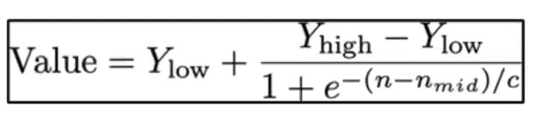
Solution for Overfitting:
Before applying Target encoding, we had split the data into train-test or modeling data and OOT data (Nov and Dec). We used only training or “past” data for target encoding.
We target encoded only DOW and Merchant State, as these two fields had >2 cardinality, yet they had enough number of records per category to be shown as examples to the model.
We also used exponential smoothing, i.e. applied an exponential function to smoothly transition between the overall target mean (y_low in the below formula) and the target mean (y_high) for each individual category. N is the number of records of the corresponding category, c is the rate of transition. We chose c as 4 and nmid as 20.

Slide 17
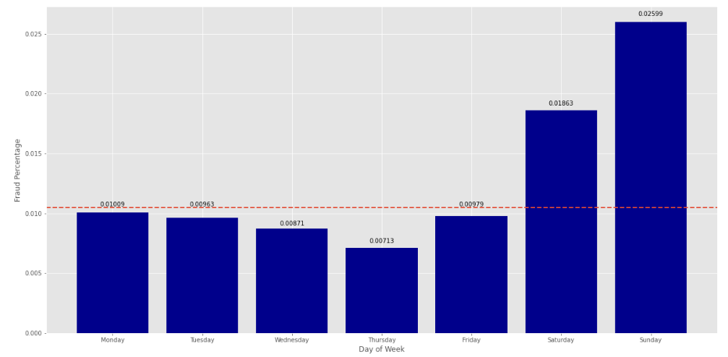
Target encoding on Day of Week

Slide 18
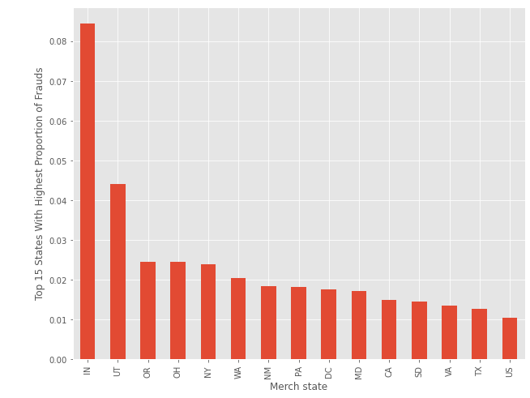
Target encoding on Merchant State

Slide 19
Feature Engineering

Slide 20
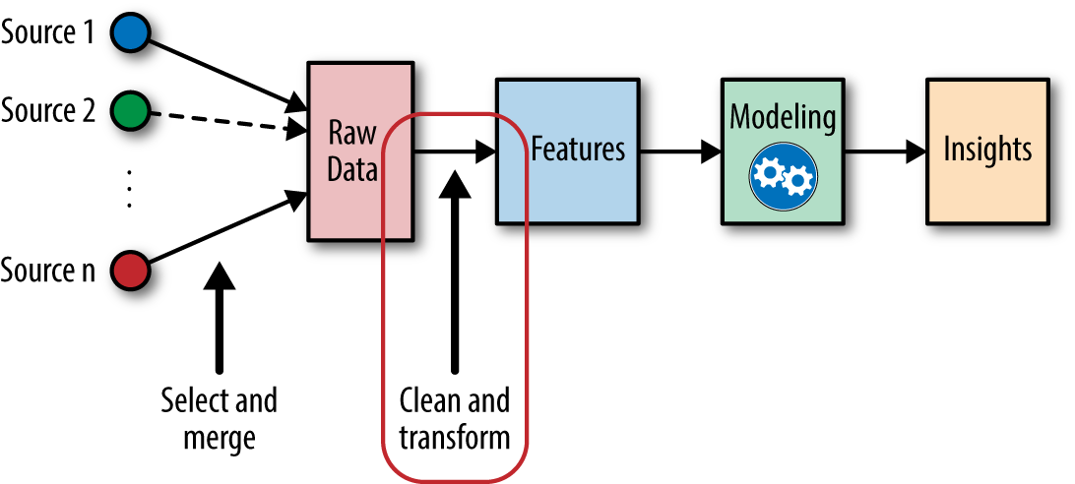
F
Feature Engineering
Features are any measurable inputs to the model.
Using domain knowledge and various techniques, feature engineering helps in preparing, transforming, and extracting features from raw data to provide the best inputs to a model.
Benefits:
Important information can get lost amidst the noise and competing signals in a large feature space.
Feature engineering allows us to collect more data and measure additional variables that can potentially improve model performance and better emphasize the trends in the data.
Many times, variables become more informative by combining them or decomposing into two or more variables.

Slide 21
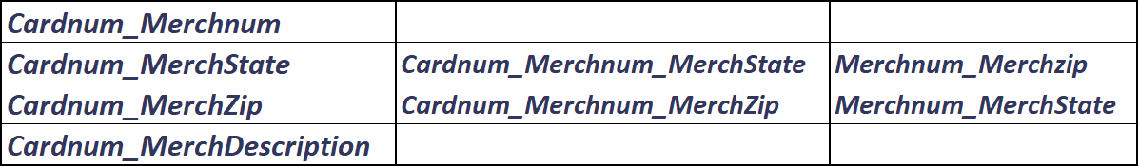
Feature Engineering: Entities
Feature Engineered Candidate Variables
Cardnum
Merchnum
MerchState
MerchZip
MerchDescription
Entities
Feature Engineered Candidate Variables
=
+

Slide 22
Feature Engineering: Building Candidate Variables
Number of Variables
Cardnum_Merchnum
Cardnum_MerchState
Cardnum_MerchZip
Cardnum_MerchDescription
Cardnum_Merchnum_MerchState
Cardnum_Merchnum_MerchZip
Merchnum_Merchzip
Merchnum_MerchState
Merch state
Merch zip
Merchnum
Merch description
Cardnum
Average
Maximum
Median
Total
Actual/average
Actual/maximum
Actual/median
Actual/total
0 days
1 day
3 days
7 days
14 days
30 days
60 days
90 days
Amount Variables
amount
by/at this
over the past
8 x 13 x 8= 832
Cardnum_Merchnum
Cardnum_MerchState
Cardnum_MerchZip
Cardnum_MerchDescription
Cardnum_Merchnum_MerchState
Cardnum_Merchnum_MerchZip
Merchnum_Merchzip
Merchnum_MerchState
Merch state
Merch zip
Merchnum
Merch description
Cardnum
0 days
1 day
3 days
7 days
14 days
30 days
60 days
90 days
Frequency Variables
Number of transactions with this
over the past
13 x 8= 104

Slide 23
Feature Engineering: Building Candidate Variables
Cardnum_Merchnum
Cardnum_MerchState
Cardnum_MerchZip
Cardnum_MerchDescription
Cardnum_Merchnum_MerchState
Cardnum_Merchnum_MerchZip
Merchnum_Merchzip
Merchnum_MerchState
Merch state
Merch zip
Merchnum
Merch description
Cardnum
Number of Variables
Days-since Variables
Current date minus date of most recent transaction with same
13
Velocity Change Variables
Number/amount of transactions with same [Entities] over past {0, 1} days by Average Number/amount of transactions with same [Entities] over past { 3, 7, 14, 30, 60, 90} days
156
Benford’s Law Variables
A variable each for Cardnum and Merchnum were created to see if they violate Benford’s Law.
2
Total number of Variables
1130

Slide 24
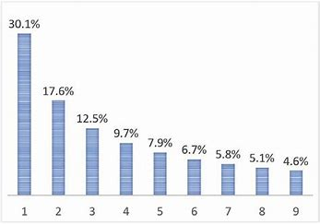
Feature Engineering: Benford’s Law
Benford's law, also known as the Newcomb–Benford law, the law of anomalous numbers, or the first-digit law, is an observation that in many real-life sets of numerical data, the leading digit is likely to be small. In sets that obey the law, the number 1 appears as the leading significant digit about 30 % of the time, while 9 appears as the leading significant digit less than 5 % of the time.
We checked the amount distribution for each Card number and Merchant number to see if they violate the Benford’s law.
1. Removed the transactions from Fedex.
2. Grouped the transactions by cardnum and merchnum.
3. Measure the unusualness of the first digit of the amount (We looked for 1s or 2s).
4. Smoothing

Slide 25
Feature Selection

Slide 26

“Feature Selection”
Feature Selection is important to reduce dimensionality.
Benefits of feature Selection:
Enables the machine learning algorithm to train faster
Reduce the complexity
Improves the accuracy
Reduces overfitting

Slide 27
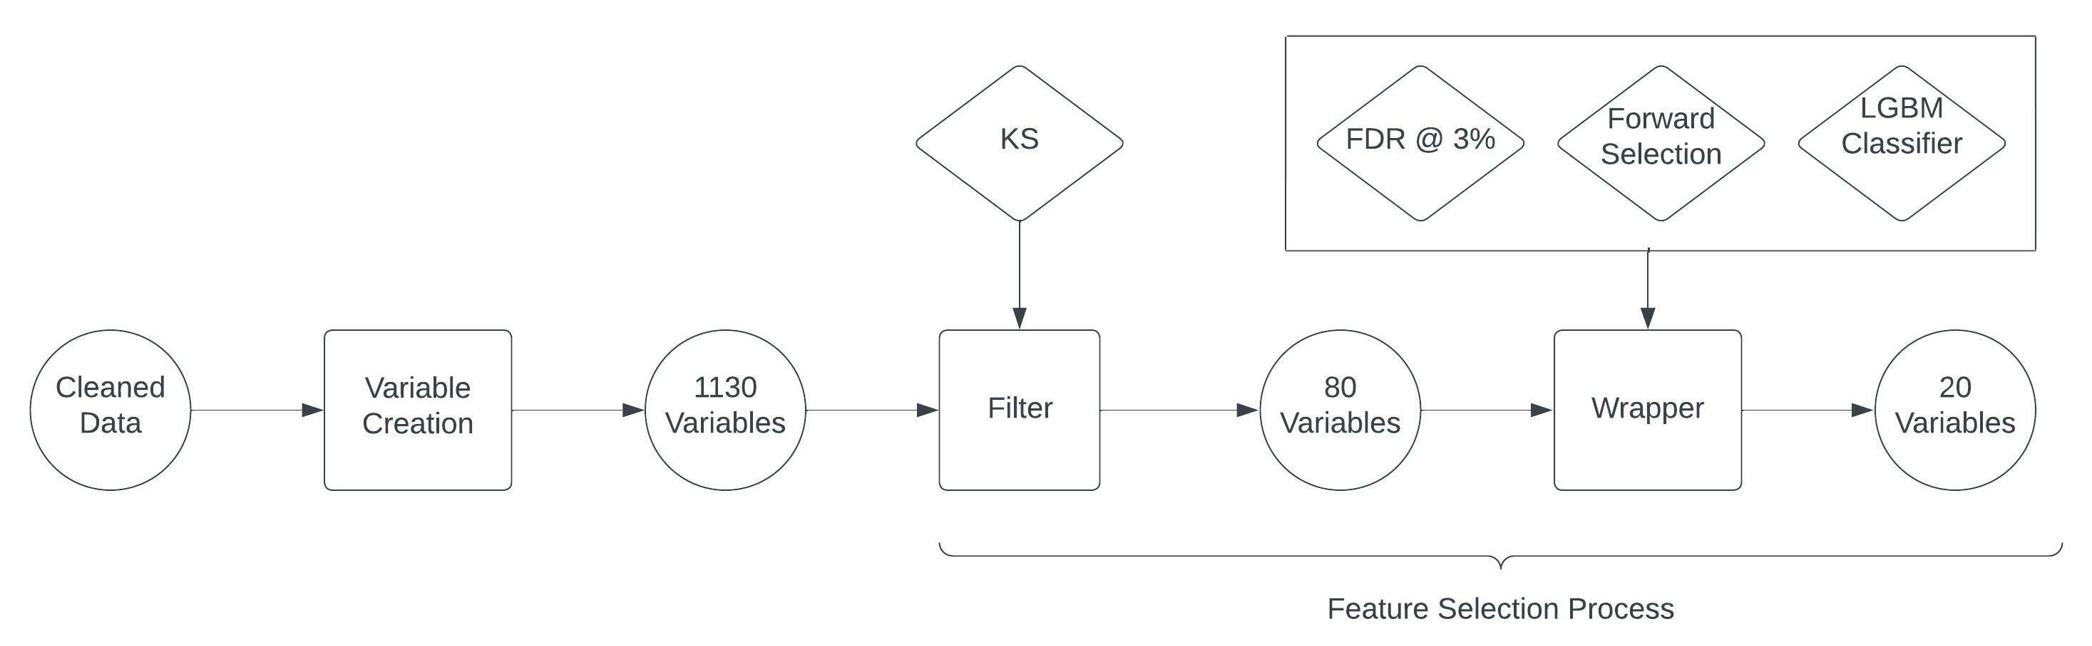
Feature Selection Flow Chart

Slide 28
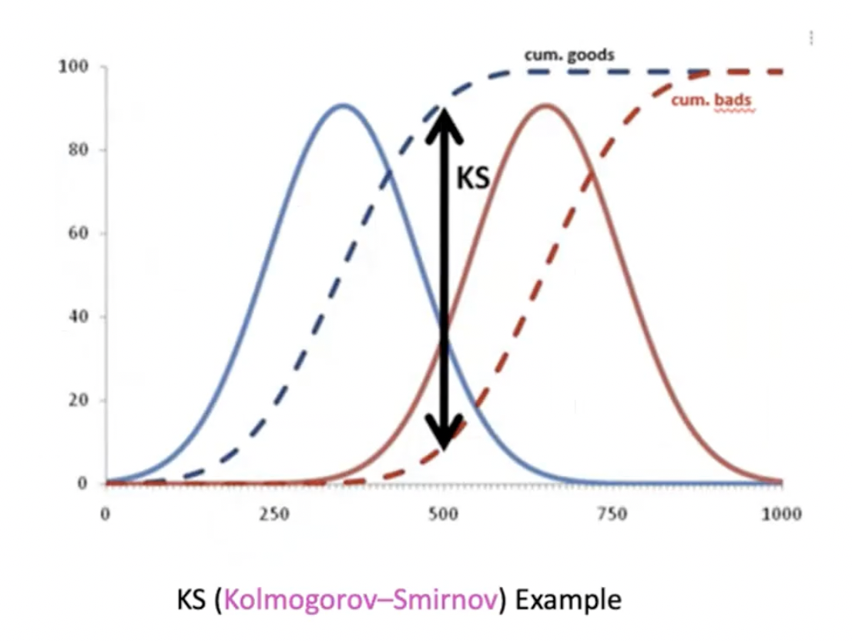
Filter Method
Purpose: to determine how relevant each variable is in predicting dependent variable on its own
Kolmogov-Smirnov(KS)
KS is a statistical measure of how well two distributions are separated into good label and a bad label population.
We calculated the difference in KS between these two distributions. More difference means the variable is more important.
We only kept only 80 variables with the highest score since they were the most significant.
Result: KS Score: Range from 0.615 to 0.681
Number of Variables:
Reduced from 1130 to 80 Variables

Slide 29
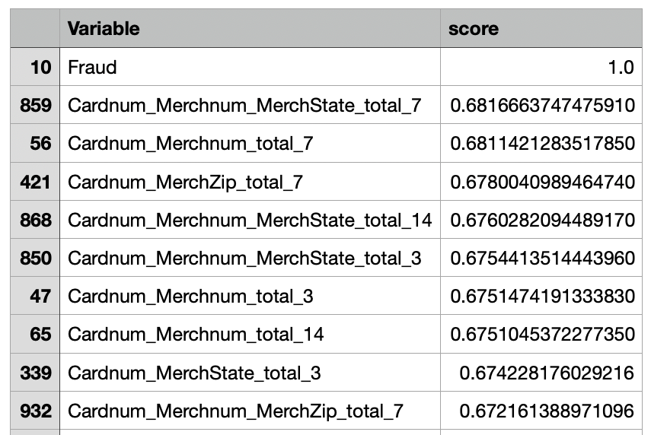
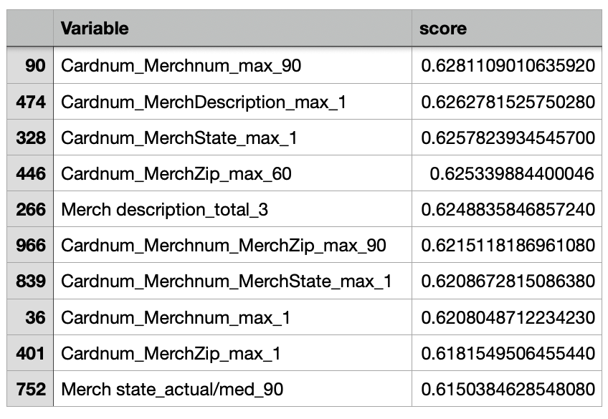
Filter Method Output of top 80 Variables
Head 10 rows
Tail 10 rows

Slide 30
Fraud Detection Rate (FDR)
Fraud detection rate(FDR) indicates what percentage of all the bads are caught at a particular examination cutoff location. For example, FDR 56% at 3% means the model catches 56% of all the frauds in 3% of the population.
In this project, we used FDR to measure the results gained from the wrapper

Slide 31

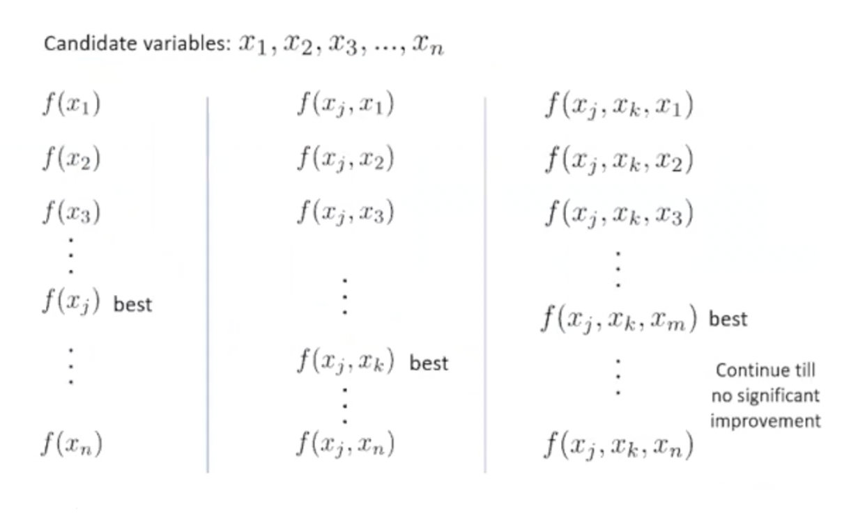
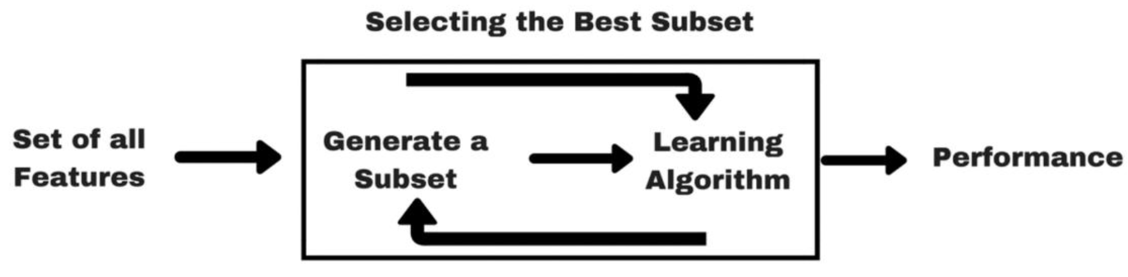
Wrapper Method
Forward Selection
Backward Selection
General stepwise selection
Forward Selection
We used forward selection method that starts with no features in the model
In each Iteration, we keep adding the feature which best improves our model till no new variable could improve the model performance.

Slide 32
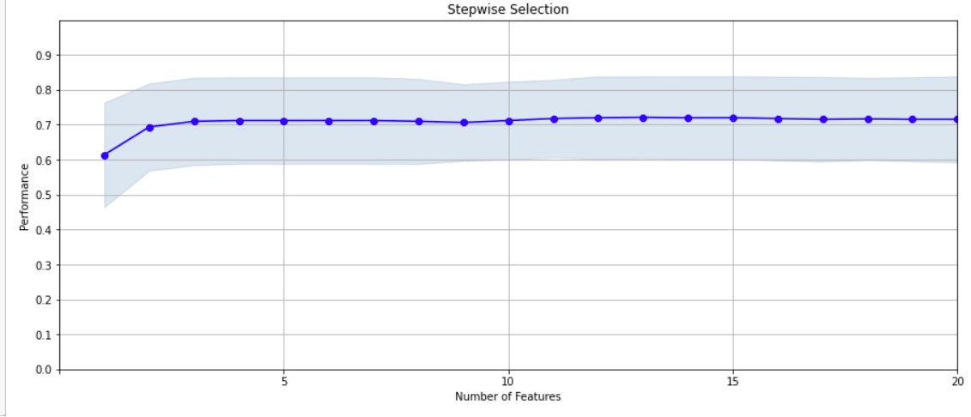
Wrapper graph
The graph on the right, shows the changes in model performance as the number of feature increase during forward selection.
If we read the graph, the performance after five features do not have significant improvement when the number of features increase.
Once we decided which independent variables to use from this graph and prepare them for analysis, we use the data from the first 10 months of our training data set.

Slide 33
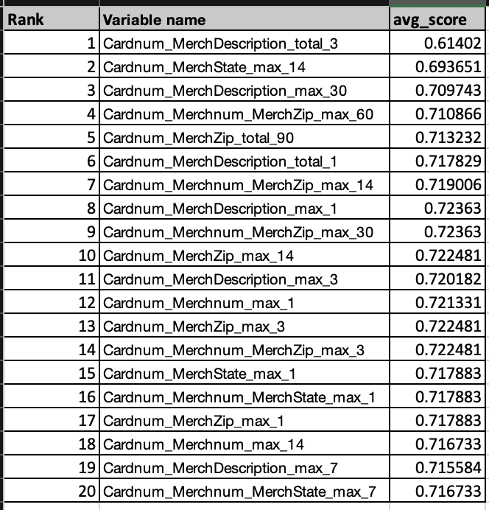
Final Variables Sorted by Wrapper
The score of these variables are quite different and not in order, because algorithm chooses the best features to maximize model performance.
Although one variable itself may not be as significant as some variables not selected during forwarding selection. It can best contribute to the model performance when it is added to a specific feature set.

Slide 34
Model Algorithms

Slide 35
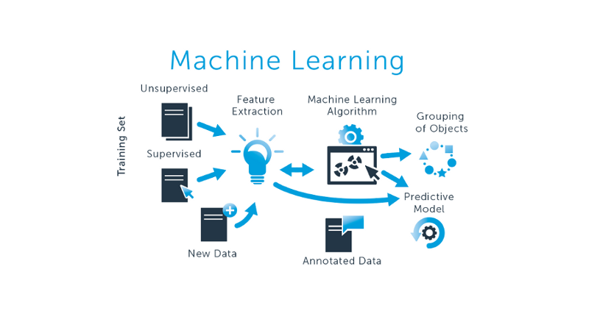
Model Algorithms:
After selecting the top 20 best variables with each having a wrapper score above 0.6, we started with a base line model and then explored several non-linear models with varying hyperparameters. The following are models which were explored:
Logistic Regression (Base Line Model)
Decision Tree
Random Forest
Gradient Boosting
Neural Network

Slide 36
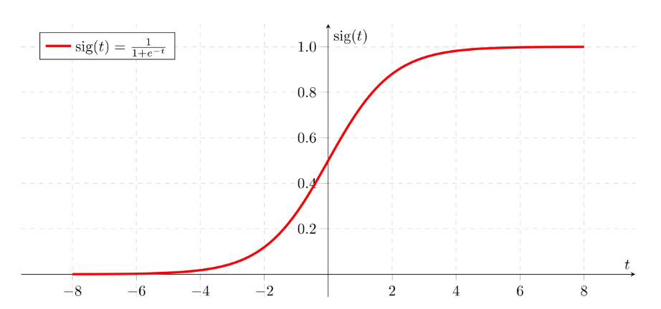
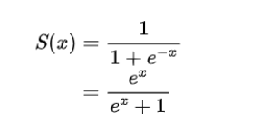
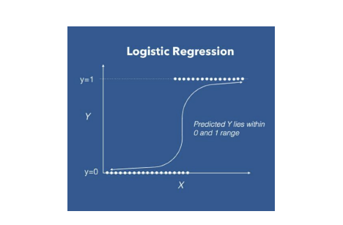
Logistic Regression
In Logistic Regression, a linear output is converted into a probability between 0 & 1 using the sigmoid function.
Computing S(x) above produces a probability that indicates if an observation should be classified as “1” (if the calculated probability is at least 0.5), and “0” otherwise.
Hyperparameters
Penalty
Solver
C
max_iter

Slide 37
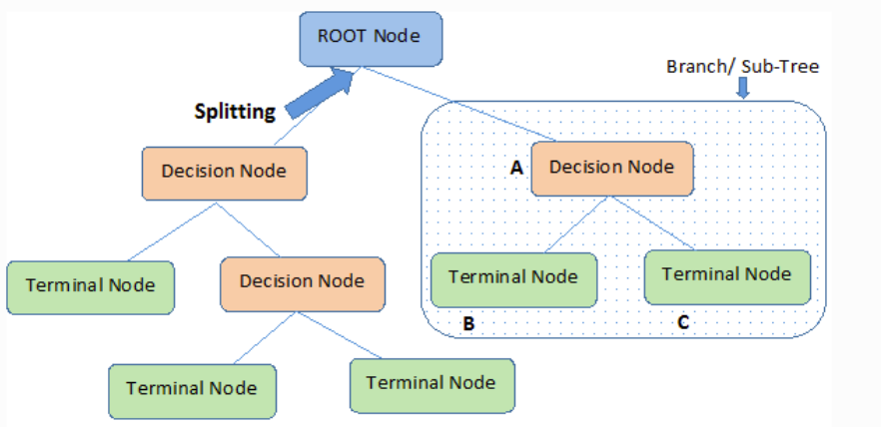
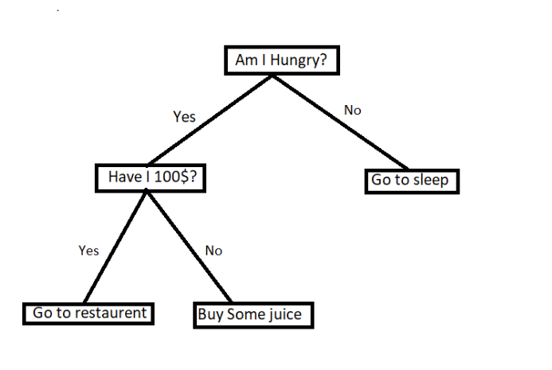
Decision Tree
Decision Tree algorithm belongs to the family of supervised learning algorithms. The decision tree algorithm can be used for solving regression and classification problems.
In Decision Trees, for predicting a class label for a record we start from the root of the tree. We compare the values of the root attribute with the record’s attribute. Based on comparison, we follow the branch corresponding to that value and jump to the next node.
Hyperparameters
Max_Depth
Min Samples Leaf
Min Samples Split
Min_weight_fraction_leaf

Slide 38
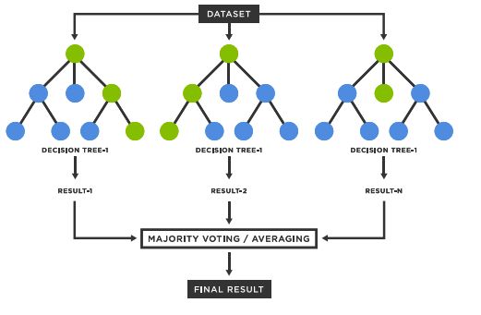
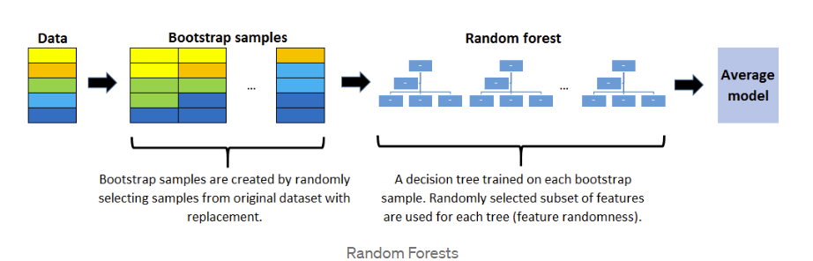
Random Forest
Random forest is an ensemble of many decision trees. Random forests are built using a method called bagging in which each decision trees are used as parallel estimators.
Utilizes bagging and feature randomness to build each individual tree to create an uncorrelated forest of trees whose prediction by committee is more accurate than that of any individual tree.
Hyperparameters
n_estimators
max_depth
max_features
num_leaves

Slide 39
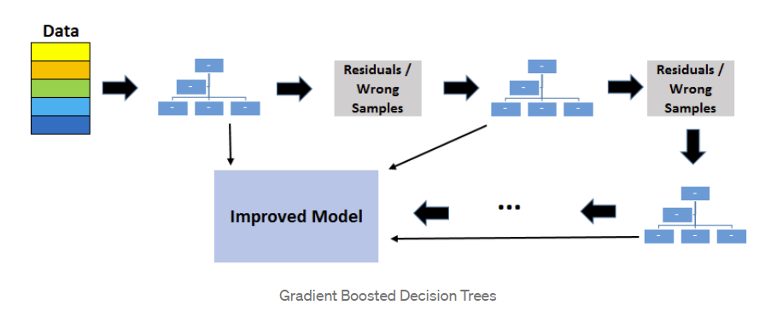
Boosted Trees
Boosting means combining a learning algorithm in series to achieve a strong learner from many sequentially connected weak learners.
Gradient boosting algorithm sequentially combines weak learners in way that each new learner fits to the residuals from the previous step so that the model improves. The final model aggregates the results from each step and a strong learner is achieved. Gradient boosted decision trees algorithm uses decision trees as weak learners.
The existing trees in the model do not change when a new tree is added. The added decision tree fits the residuals from the current model.
Hyperparameters
learning_rate
n_estimators
max_depth
num_leaves

Slide 40
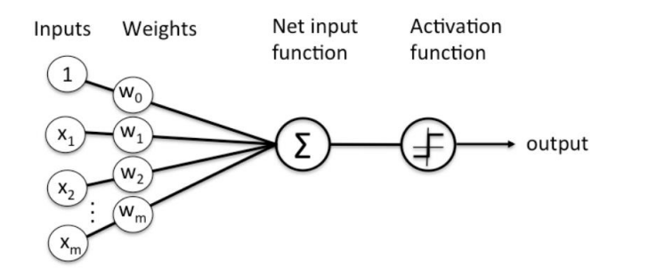
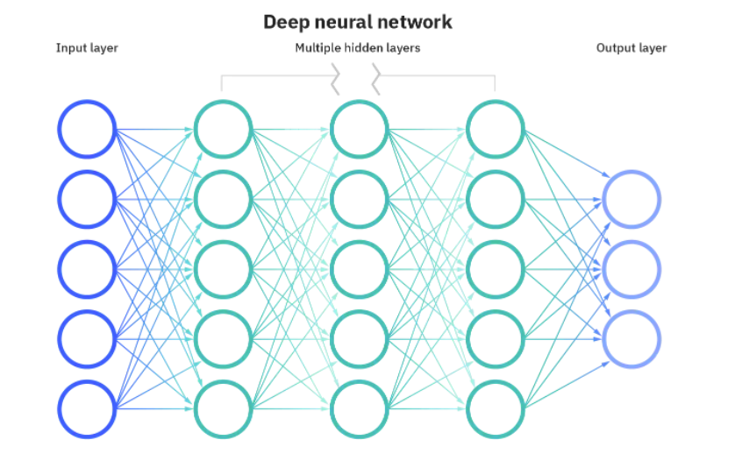
Neural Networks
Neural network function in a way like biological neurons. They take in various inputs (at input layers), weight these inputs, and then combine the weighted inputs through a linear combination.
Combined weighted output is past some thresholds set by an activation function, the output is then set out to other layers
Base unit is generally referred to as a perceptron. Perceptron’s are combined to form neural networks.
Hyperparameters
activation
max_iter
learning_rate
alpha

Slide 41
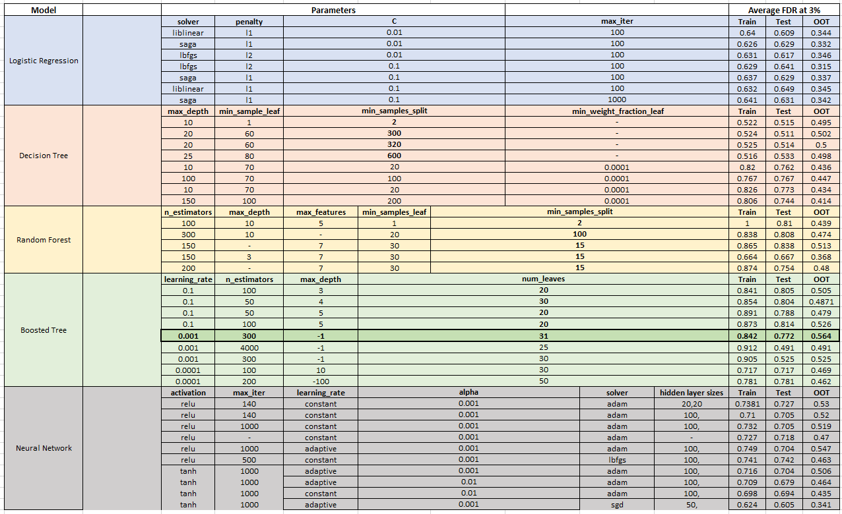
Model Results

Slide 42
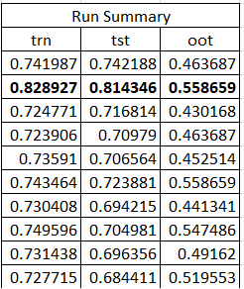
Final Model Result
Final Model -> Gradient Boosted Tree
Final Hyperparameters
Learning_rate
N_estimators
Max_depth
Num_leaves
OOT Result -> 55.8 % FDR @ 3 %

Slide 43
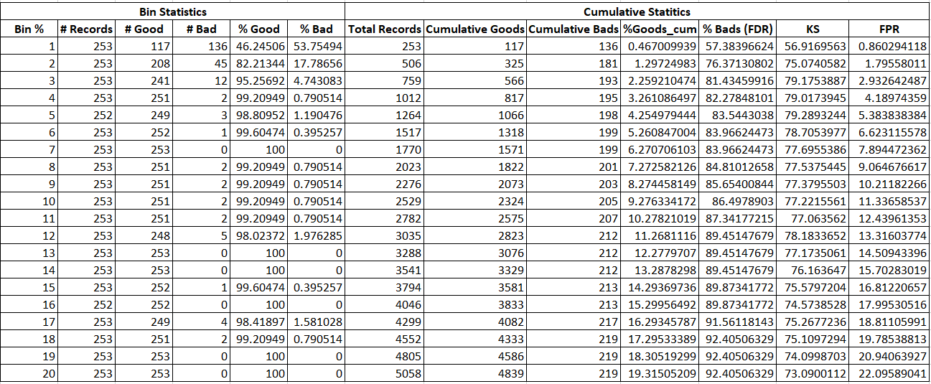
Best Model Testing Result

Slide 44
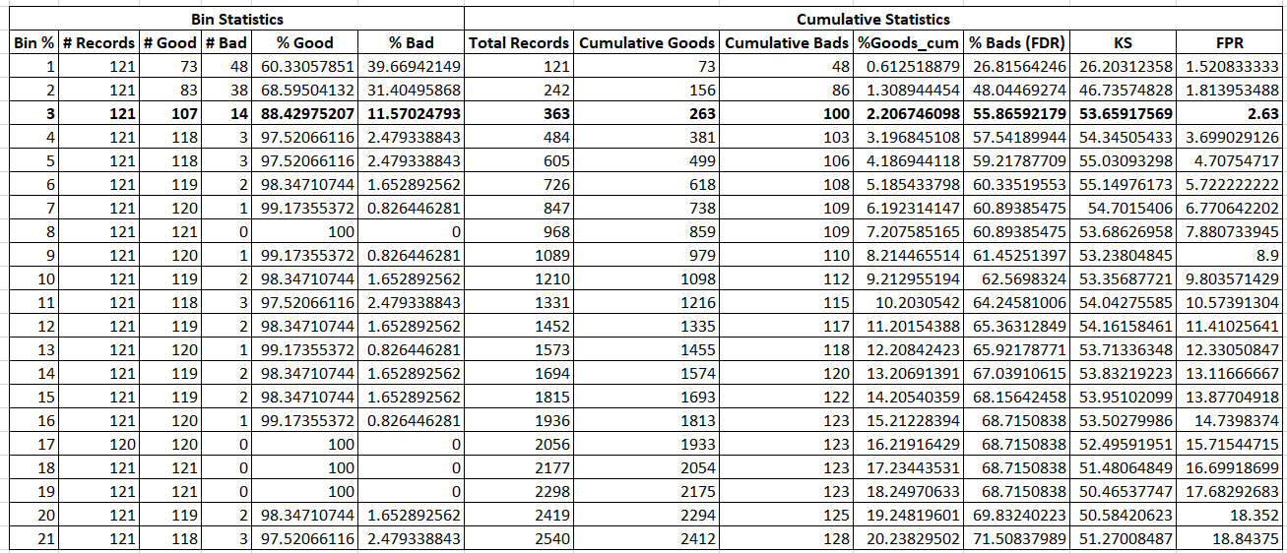
Best Model OOT Validation Result

Slide 45
Conclusion
Performed Exploratory Data Analysis on the data to explore important data fields which gives us a better understanding about the distribution of data.
Data Cleaning & Imputation-> Filtering -> Missing value Imputation
Performed Feature Engineering to build multiple candidate variables which better highlights the fraudulent behaviors. With right set of features, we can get better results during model selection
Created 1130 variables -> Performed Filter process to reduce it to 80 variables -> Wrapper method (Forward Selection) with 20 variables.
Ran Linear and Non-Linear models with different hyperparameters. Gradient Boosted Tree was our final Model with the below results -> OOT Result -> 55.8 % FDR @ 3 %
Future Improvements -> Explore other deep learning models (KNN) -> Collect more dataset -> Handle Imbalance in Data -> Reach out to Domain Experts

